Slide 1
Unit-2
NoSql

Slide 2
Comparison Between RDMS and NoSql
Point of difference | RDBMS | NoSQL
Data model | Uses relational model: data in tables with rows and columns. | Uses non‑relational models: key‑value, document, column‑family, graph, etc.
Schema | Fixed, predefined schema; structure must be designed before inserting data. | Schema‑less or flexible schema; records can have different fields.
Query language | Standard SQL for defining and querying data. | No single standard; queries via JSON‑like syntax, APIs, or custom languages.
Relationships & joins | Strong support for relationships with primary/foreign keys and JOINs. | Usually avoids complex joins; prefers embedded or denormalized data.
Transactions & consistency | Strong ACID guarantees; reliable multi‑row transactions. | Often BASE and eventual consistency, focusing on availability and speed.
Scalability | Mainly vertical scaling (bigger single server). | Designed for horizontal scaling across many nodes.
Data type suitability | Best for highly structured, stable data with clear relations. | Better for semi‑structured, unstructured, or frequently changing data.

Slide 3
Comparison Between RDMS and NoSql (Con…)
Normalization | Uses normalization to reduce redundancy; data split into many related tables. | Often denormalized to keep related data together for faster reads.
Typical use cases | Banking, ERP, inventory, finance, where strict consistency and complex queries are needed. | Big data, analytics, social networks, content management, IoT, high‑traffic web apps.
Examples | MySQL, PostgreSQL, Oracle, SQL Server. | MongoDB, Cassandra, Redis, HBase, Neo4j, DynamoDB.
Flexibility & schema change | Schema changes (like adding columns) can be slow on large databases. | New fields can be added easily without global schema migration.
Performance focus | Very good for complex joins and strict transactional workloads, but may struggle with huge distributed writes. | Optimized for high read/write throughput and large scale; complex multi‑record transactions may be limited.
Fault tolerance & distribution | Traditionally single primary with optional replicas; risk of single point of failure. | Built around distributed clusters with automatic replication and partitioning.

Slide 4
RDBMS Approach
The RDBMS (Relational Database Management System) approach stores data in a structured, tabular format and follows strict rules to ensure data accuracy, consistency, and reliability.
Key Characteristics of RDBMS Approach:
Table-Based Data Model
Data is stored in tables (relations) with rows and columns.
2. Fixed Schema
Schema must be defined before data insertion.
Structure cannot be changed easily.
3. Structured Query Language (SQL)
Uses SQL for data definition and manipulation.
Supports complex queries and joins.

Slide 5
Key Characteristics of RDBMS Approach:
4. ACID Transactions
Ensures Atomicity, Consistency, Isolation, and Durability.
Suitable for transaction-critical applications.
5.Strong Consistency
All users see the same data at the same time.
Ideal for financial and enterprise systems.
6. Normalization
Reduces data redundancy.
Improves data integrity.
7. Referential Integrity
Maintains relationships using primary and foreign keys.

Slide 6
Key Characteristics of RDBMS Approach:
8. Concurrency Control
Manages multiple users safely.
Uses locks, isolation levels, and transactions.
9. Centralized Architecture
Usually runs on a single server or tightly coupled cluster.
10. Vertical Scalability
Scales by increasing CPU, RAM, or storage.
Limited scalability compared to NoSQL.

Slide 7
Advantages of RDBMS Approach
High data accuracy and integrity
Mature and well-tested technology
Strong security and access control
Powerful reporting and analytics

Slide 8
Limitations of RDBMS Approach
Difficult to scale horizontally
Poor performance with very large data sets
Not suitable for unstructured data
High cost for large-scale deployments

Slide 9
Challenges of NoSQL Approach
The NoSQL approach is designed for scalability and performance, but it also introduces several challenges.
Key Challenges
Eventual Consistency:
Data may not be immediately consistent across all nodes.
Different users may see different values temporarily.
2. Limited Transaction Support
Full ACID transactions are often not supported.
Mostly supports single-record atomic operations.

Slide 10
Challenges of NoSQL Approach
3. Lack of Standard Query Language
No common query language like SQL.
Each NoSQL database has its own APIs and syntax.
4. Data Duplication
Data is often denormalized to improve performance.
Leads to extra storage and data maintenance issues.
5. Complex Application Logic
Consistency and integrity handled at application level.
Increases development complexity.
6. Debugging and Maintenance Difficulty
Distributed systems are harder to debug.
Node failures and network issues complicate management.

Slide 11
Challenges of NoSQL Approach
7. Security Limitations
Some NoSQL databases provide weaker security features compared to RDBMS.
8. Learning Curve
Developers must learn new data models and tools.

Slide 12
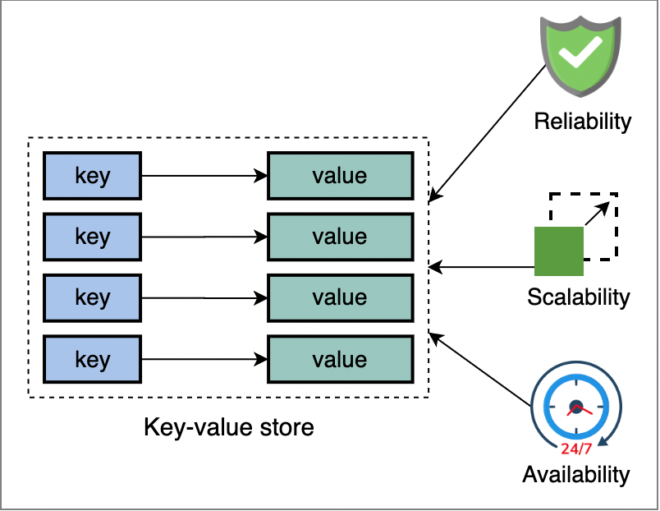
Key–Value Data Model
Definition:
The Key–Value Data Model stores data as a collection of key–value pairs, where each key is unique and is used to retrieve its corresponding value.
Structure
Key → Value
Examples
Redis , Amazon DynamoDB, Riak
Key Characteristics
Simple and lightweight data model
Very fast data access
Schema-less storage
Highly scalable
Values can be strings, objects, or binary data

Slide 13
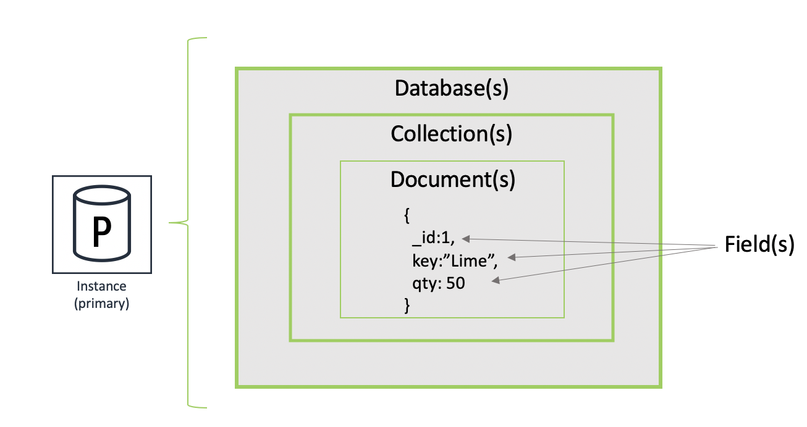
Document Data Model:
The Document Data Model stores data as documents (usually in JSON/BSON/XML format).
Each document contains key–value pairs and can have nested structures.
Structure
{
"id": 101,
"name": “Ravi",
"course": "CSE",
"skills": ["Java", "MongoDB"]
}
Key Characteristics:
Schema-less / flexible schema
Supports nested and complex data
Easy object mapping for applications
No joins required (data stored together)
Highly scalable and distributed

Slide 14
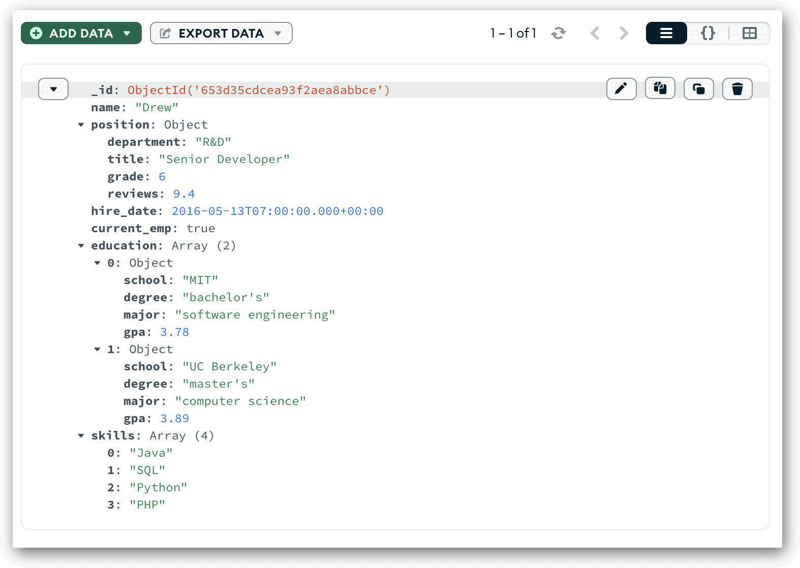
Use Cases
Web & mobile applications
Content management systems
RESTful APIs
E-commerce catalogs
Advantages
Flexible data structure
Faster reads (no joins)
Developer-friendly (JSON)
Examples
MongoDB
CouchDB
Firebase Firestore

Slide 15
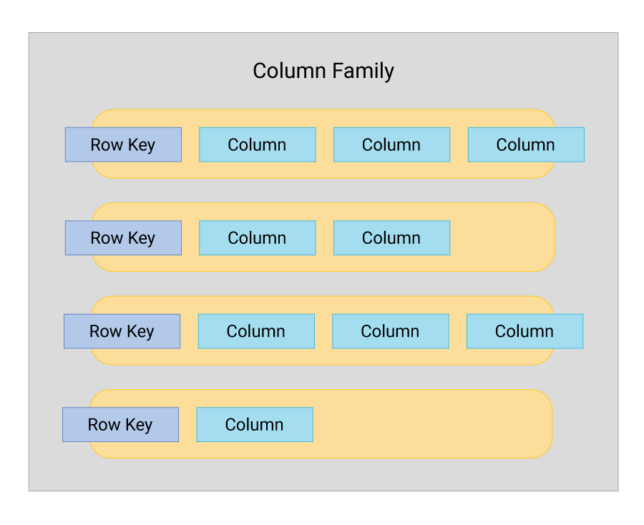
Column-Family Stores:
Column-Family Stores are NoSQL databases that store data in columns grouped into column families, instead of traditional rows.
They are optimized for large-scale and distributed data storage.
Structure :
Row Key | Column Family: UserDetails
| Name | Email | Phone
Key Characteristics
Data stored in columns, not rows
Columns grouped into column families
Schema is flexible within families
High write and read performance
Designed for distributed clusters

Slide 16
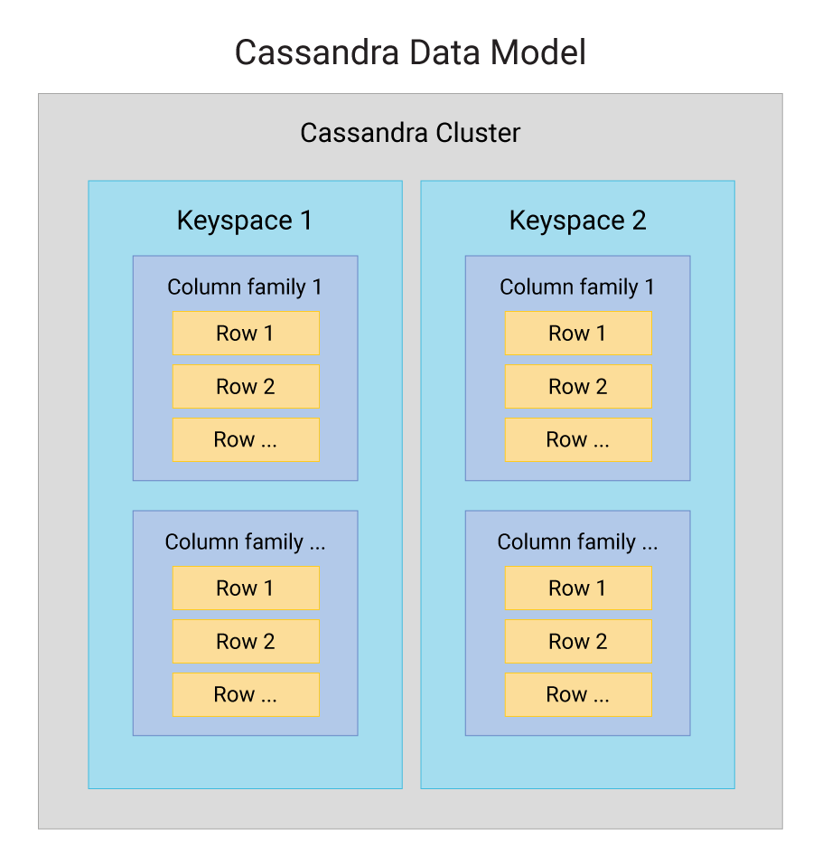
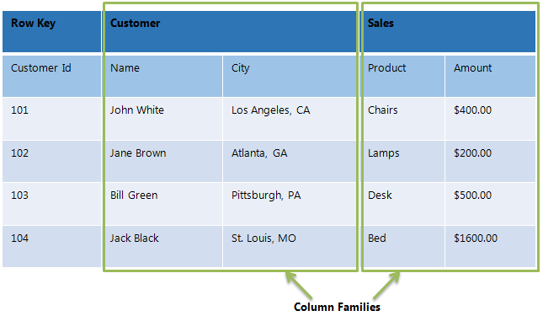
Advantages
Handles huge volumes of data
Highly scalable and fault tolerant
Efficient for range-based queries
Use Cases
Time-series data
Analytics systems
Logging and monitoring
Big data applications
Examples
Apache Cassandra
Apache HBase
Google Bigtable

Slide 17
MongoDB
MongoDB is a NoSQL, document-oriented database that stores data in JSON-like documents (BSON).
It is designed for flexibility, scalability, and high performance.
Uses of MongoDB (Why it is Used)
Stores semi-structured and unstructured data
Supports flexible (schema-less) data models
Provides fast read and write operations
Easy object-to-document mapping for applications
Supports horizontal scaling

Slide 18
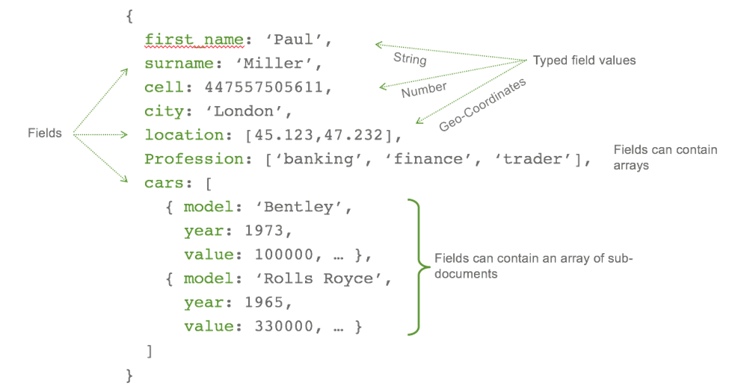

Slide 19
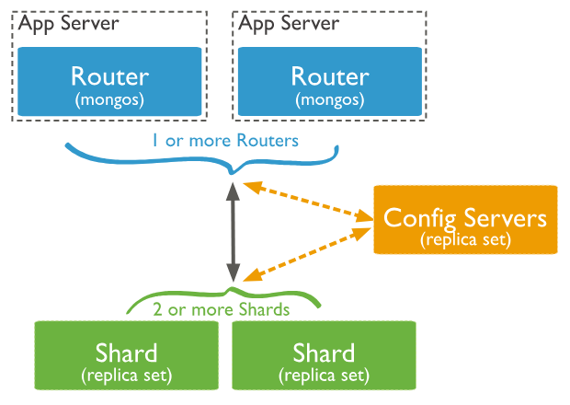
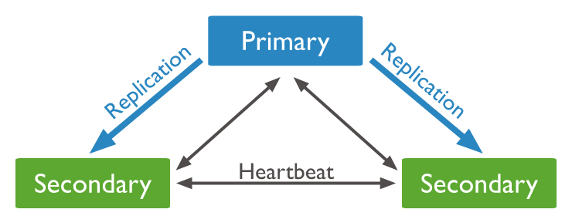
Deployment of MongoDB
1. Standalone Deployment
Single MongoDB server
Used for development and testing
        Application → MongoDB Server
        2. Replica Set Deployment
        Multiple copies of data
        Ensures high availability and fault tolerance
                Primary → Secondary → Secondary
3. Sharded Cluster Deployment
Data distributed across multiple servers
Ensures scalability and load balancing

Slide 20
Applications of MongoDB
Web and mobile applications
Content Management Systems (CMS)
E-commerce platforms
Real-time analytics
IoT applications
Social media platforms
RESTful APIs
Advantages of MongoDB
Flexible schema
High performance
Easy to scale
Supports replication and sharding
Developer-friendly (JSON format)

Slide 21
Apache Cassandra
Apache Cassandra is a NoSQL, column-family (wide-column) database designed for high availability, fault tolerance, and massive scalability.
It is especially suitable for distributed systems where downtime is unacceptable.
Uses of Cassandra (Why it is Used)
Handles huge volumes of data
Supports high write throughput
Provides continuous availability (no single point of failure)
Designed for horizontal scalability
Works efficiently across multiple data centers

Slide 22
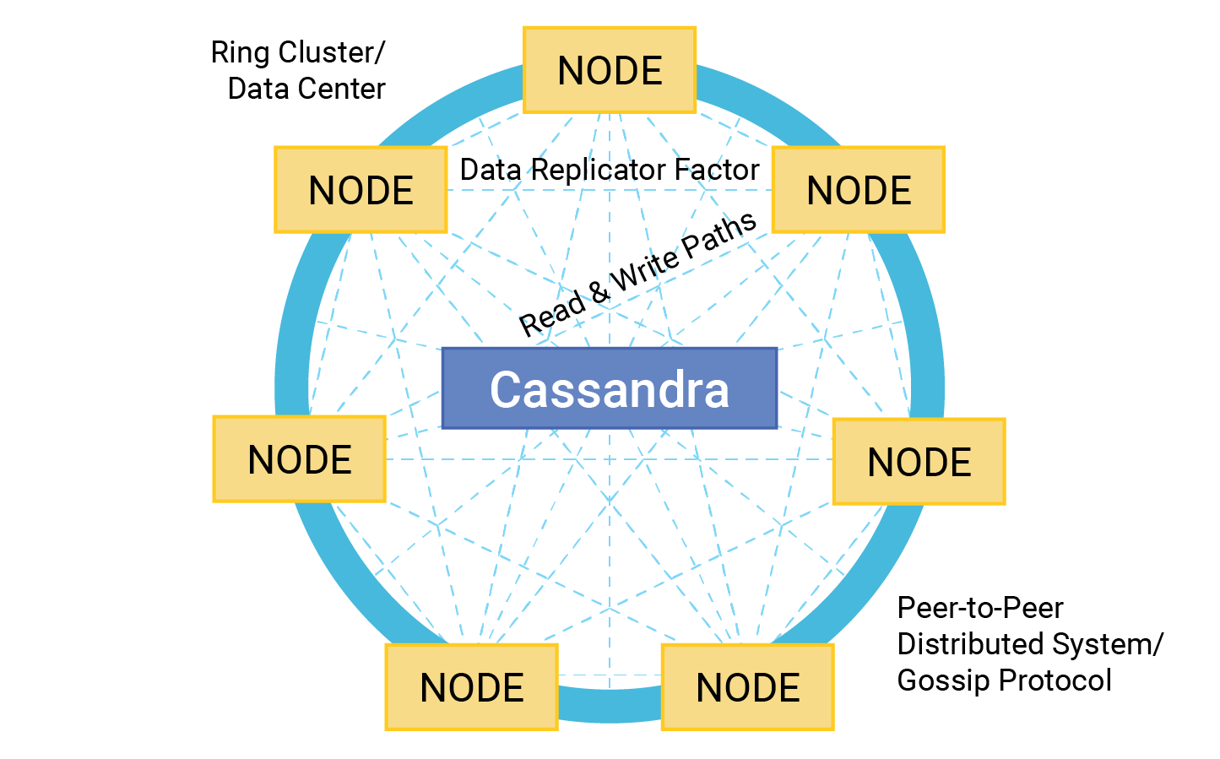
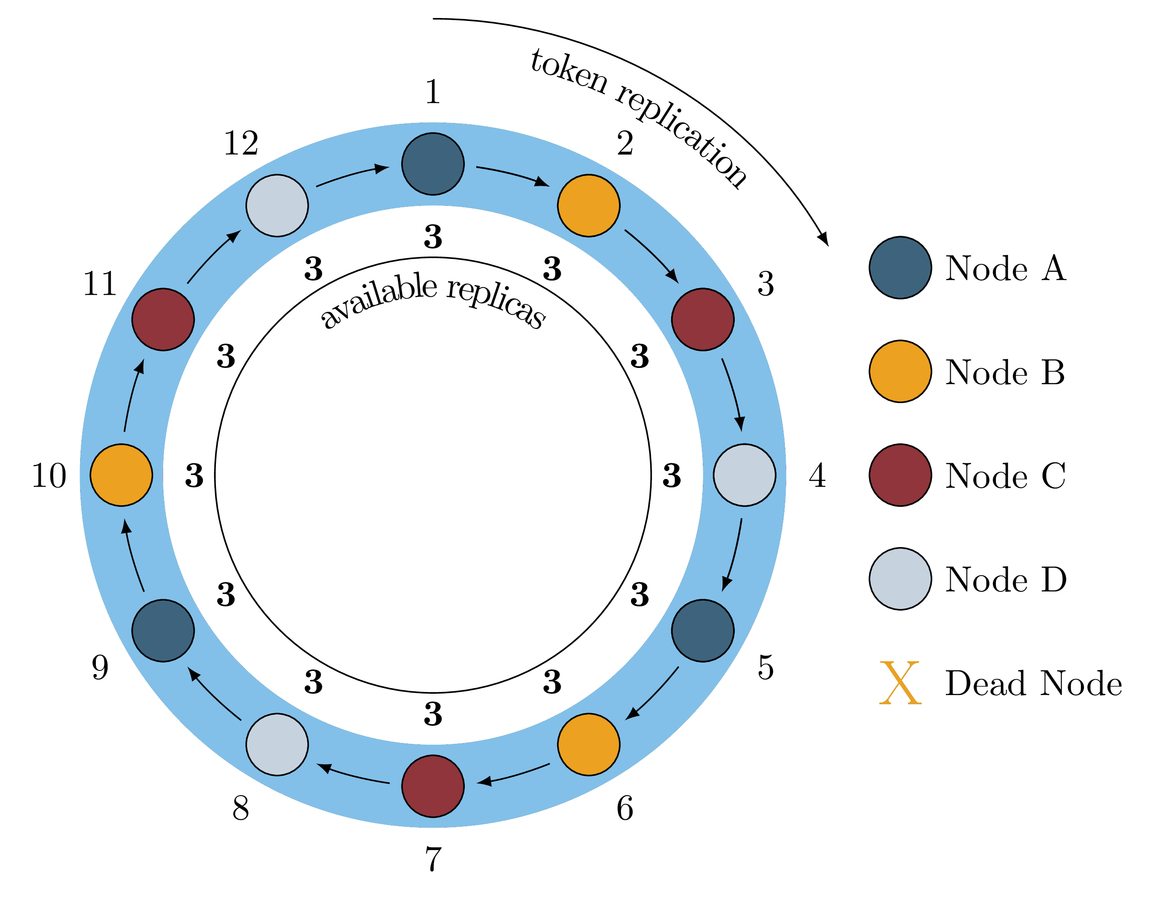
Deployment of Cassandra
1. Peer-to-Peer Architecture
All nodes are equal
No master or slave
Eliminates single point of failure
Node ↔ Node ↔ Node
2. Ring-Based Cluster
Nodes arranged in a ring topology
Data distributed using consistent hashing
      Node1 → Node2 → Node3 → Node4 → Node1
3. Replication Strategy
Data replicated across multiple nodes
Ensures fault tolerance
Write → Node A → Node B → Node C

Slide 23
Applications of Cassandra
Real-time analytics
IoT and sensor data
Messaging systems
Recommendation engines
Time-series data
Online transaction logging
Social media platforms
Advantages of Cassandra
Highly available (no downtime)
Linear scalability
Handles large write-heavy workloads
Fault tolerant and reliable
Suitable for global applications

Slide 24
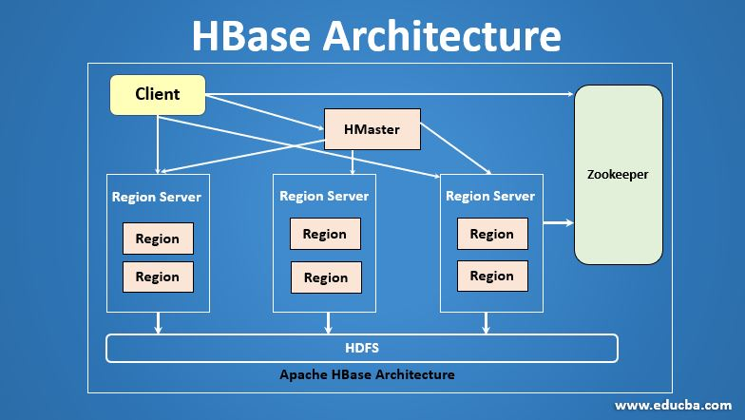
Apache HBase
Apache HBase is a NoSQL, column-family (wide-column) database built on top of Hadoop HDFS.
It is designed to handle very large datasets and provide real-time read/write access to big data.
Uses of HBase (Why it is Used)
Stores huge volumes of structured and semi-structured data
Provides random, real-time read/write access
Integrates tightly with Hadoop ecosystem
Handles sparse data efficiently
Suitable for big data applications

Slide 25
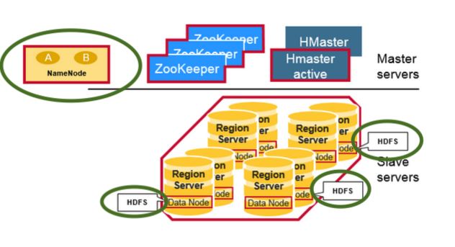
Deployment of Hbase
1. HBase on Hadoop (HDFS-Based)
Data stored in HDFS
Uses Hadoop for distributed storage
      Application → HBase → HDFS
2. Master–Region Server Architecture
HMaster manages the cluster
RegionServers store and serve data
Tables split into regions
HMaster
|
-----------------
| RegionServer 1 |
| RegionServer 2 |
| RegionServer 3 |
-----------------

Slide 26
3. Zookeeper Coordination
Uses Apache ZooKeeper
Handles configuration, coordination, and failure recovery
Client → ZooKeeper → HBase Cluster
Applications of HBase
Big data analytics
Time-series data storage
Log and event data processing
IoT data storage
Recommendation systems
Search indexing systems

Slide 27
Advantages of HBase
Scales to billions of rows and millions of columns
High availability and fault tolerance
Strong consistency at row level
Efficient handling of sparse datasets
Works well with Hadoop tools (MapReduce, Spark)

Slide 28
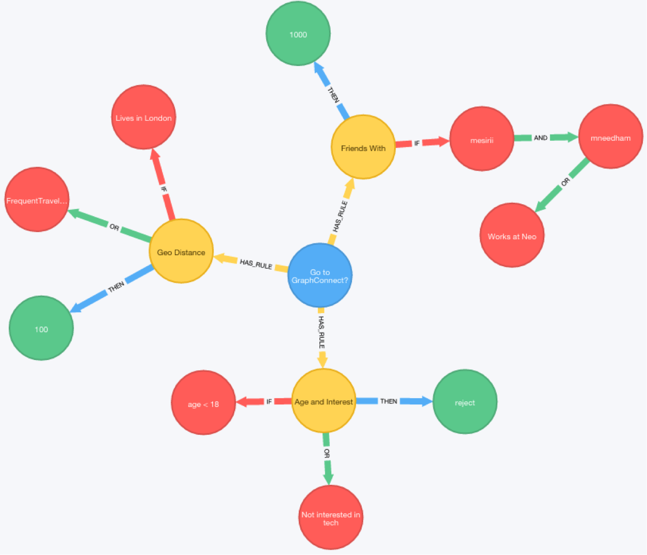
Neo4j
Neo4j is a NoSQL, graph-oriented database that stores data in the form of nodes, relationships, and properties.
It is designed to efficiently manage and query relationships between data.
Uses of Neo4j (Why it is Used)
Handles highly connected data
Provides fast relationship traversal
Avoids expensive joins used in RDBMS
Supports complex relationship-based queries
Uses Cypher Query Language (CQL)

Slide 29
Data Model in Neo4j
Node → Represents an entity (Person, Product, Place)
Relationship → Represents connection between nodes
Properties → Key–value pairs stored in nodes/relationships
Deployment of Neo4j
1. Standalone Deployment
Single Neo4j server
Used for development and small applications
Application → Neo4j Server

Slide 30
2. Cluster Deployment
Multiple Neo4j instances
Provides high availability and fault tolerance
Application
|
Neo4j Cluster
/ | \
Node1 Node2 Node3
3. Read Replicas
Separate nodes for read operations
Improves read scalability
Write Node → Read Replicas

Slide 31
Applications of Neo4j
Social networking applications
Recommendation systems
Fraud detection
Knowledge graphs
Network and IT operations
Routing and path-finding applications
Advantages of Neo4j
Extremely fast relationship queries
Intuitive graph data model
High performance for connected data
Easy to model real-world relationships
ACID-compliant transactions

Slide 32
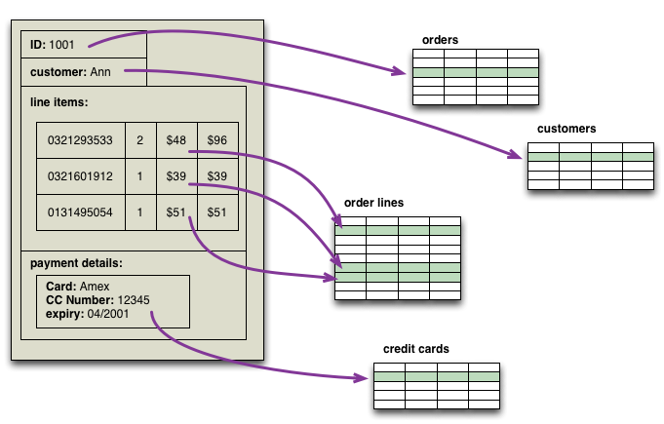
Aggregate-Oriented Databases
Aggregate-oriented databases are NoSQL databases that store and manage data as aggregates, where an aggregate is a group of related data that is stored, retrieved, and updated as a single unit.
What is an Aggregate?
An aggregate represents data that is commonly accessed together.
Example:
A customer order containing customer details, order items, and payment information stored together as one unit.

Slide 33
Key Characteristics
Data is handled as one complete unit
No complex joins are required
Uses denormalized data
Supports horizontal scalability
Well suited for distributed systems
Types of Aggregate-Oriented Databases
Key–Value Stores
Document Databases
Column-Family Stores
Advantages
Faster data access
Simple data modeling
High performance and scalability

Slide 34
Aggregate-Oriented vs Relational (Visual Comparison)
Relational Database Aggregate-Oriented Database
--------------------- -----------------------------
Customer Table Order Aggregate
Order Table ----> (Customer + Order + Items)
Items Table
(Multiple Joins) (Single Read)

Slide 35
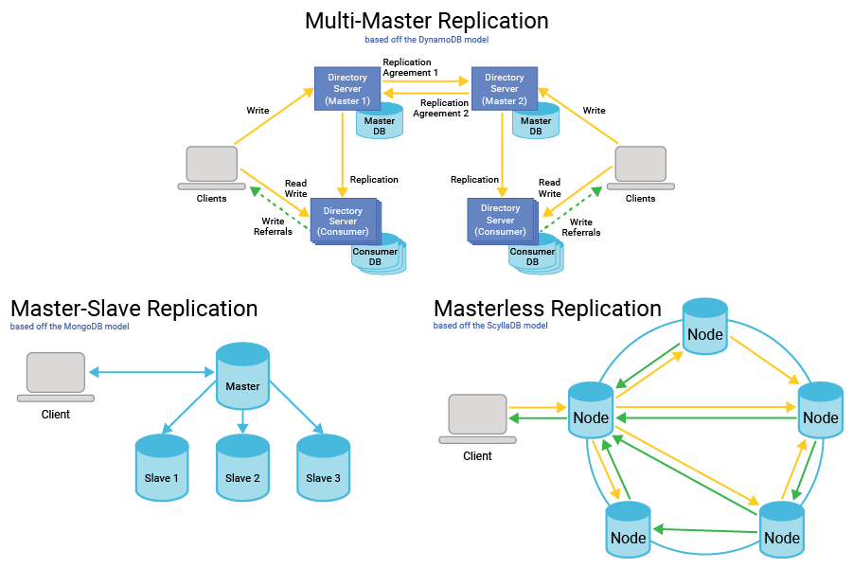
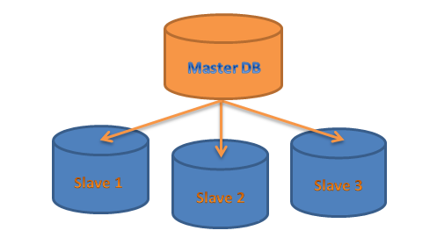
Replication and Sharding
Replication
Definition
Replication is the process of copying the same data across multiple database nodes to improve availability, fault tolerance, and reliability.
Why Replication is Needed
Prevents data loss
Ensures high availability
Supports fault tolerance
Improves read performance

Slide 36
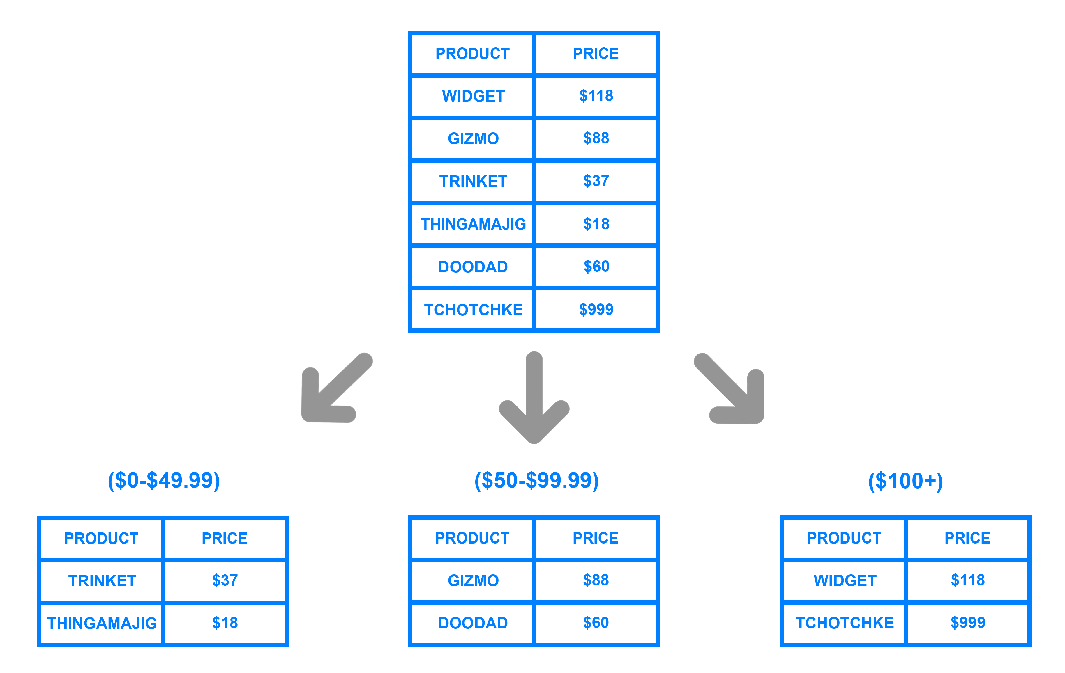
Sharding (Data Sharing / Distribution)
Definition
Sharding is the process of dividing large data into smaller parts (shards) and distributing them across multiple nodes.
Why Sharding is Needed
Handles large data volumes
Improves scalability
Balances load across servers

Slide 37
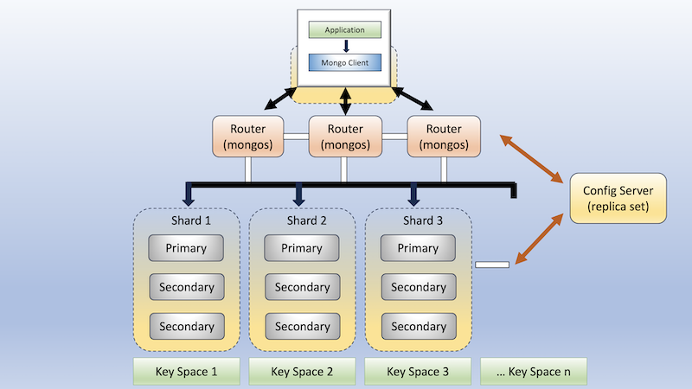

Slide 38
MapReduce on Databases
MapReduce is a programming and processing model used to process large volumes of data stored in databases or distributed storage systems by dividing the work into Map and Reduce phases.
It is widely used with big data databases and distributed systems.
Why MapReduce is Used on Databases
To process huge datasets efficiently
To support parallel processing
To improve performance on distributed data
To analyze data stored across multiple nodes

Slide 39
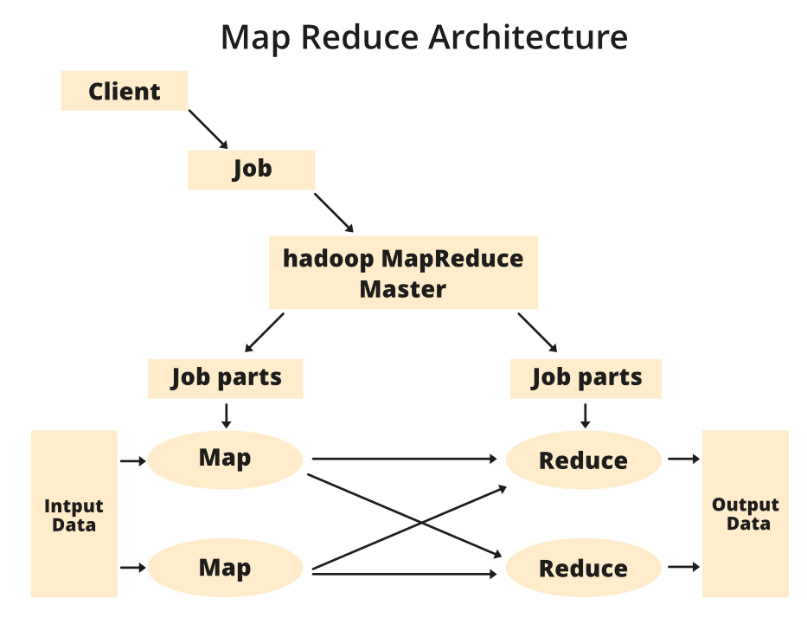

Slide 40
MapReduce Phases
1. Map Phase
Input data is divided into chunks
Each chunk is processed independently
Produces key–value pairs
Input: "NoSQL is scalable“
Map Output:
(NoSQL, 1)
(is, 1)
(scalable, 1)

Slide 41
2. Shuffle & Sort (Intermediate Step)
Groups all values by key
Sends same keys to the same reducer
(NoSQL, [1,1,1])
3. Reduce Phase
Aggregates values
Produces final output
(NoSQL, 3)

Slide 42
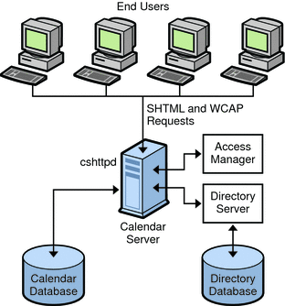
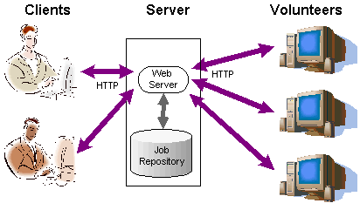
Distributed Models in Databases
Distributed models define how data is stored and managed across one or more servers.
1. Single Server Model
In the single server model, the entire database runs on one machine.
or
The Single Server Model is a database architecture in which the entire database system runs on a single machine. All data storage, processing, and query handling are performed by one server.
Key Characteristics
One server handles all read and write operations
Centralized architecture
Simple setup and management
No data distribution

Slide 43
Limitations
Single point of failure
Limited scalability
Performance degrades with high load
Use Cases
Small applications
Development and testing environments
Low-traffic systems

Slide 44
2. Sharding (Data Partitioning)
Definition
Sharding is a database technique in which large datasets are divided into smaller parts called shards, and each shard is stored on a different server.
It is used to improve scalability and performance.
Characteristics
Data is horizontally partitioned
Each shard contains different subset of data
All shards together represent the complete database
Queries are distributed across shards
Application
|
├── Shard 1 (Data Part 1)
├── Shard 2 (Data Part 2)
└── Shard 3 (Data Part 3)

Slide 45
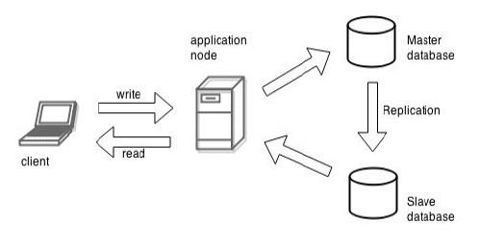
3. Master–Slave Replication
Master–Slave Replication is a database architecture in which one master node handles all write operations, and one or more slave nodes replicate data from the master and handle read operations.
Key Characteristics
Master performs insert, update, and delete operations
Slaves maintain copies of master data
Data is replicated from master to slaves
Improves read performance

Slide 46
Advantages
High read scalability
Data redundancy
Improved availability for read operations
Limitations
Master is a single point of failure
Write scalability is limited
Replication delay may occur

Slide 47
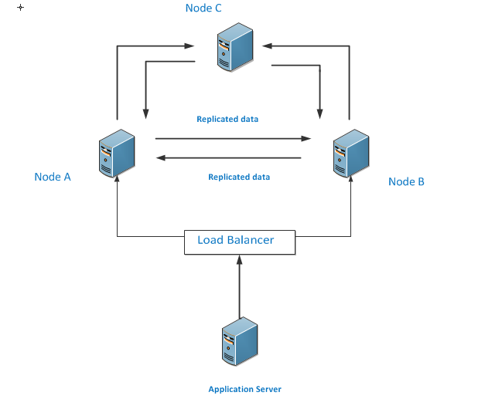
Peer-to-Peer Replication
Definition
Peer-to-Peer Replication is a database replication model in which all nodes are equal and can handle both read and write operations.
There is no master node, and data is replicated among all peers.
Key Characteristics
No master–slave hierarchy
All nodes are equal peers
Supports read and write on any node
High availability and fault tolerance

Slide 48
Advantages
No single point of failure
Better availability
Scales well horizontally
Limitations
Data conflicts may occur
Eventual consistency is common
Complex conflict resolution

Slide 49
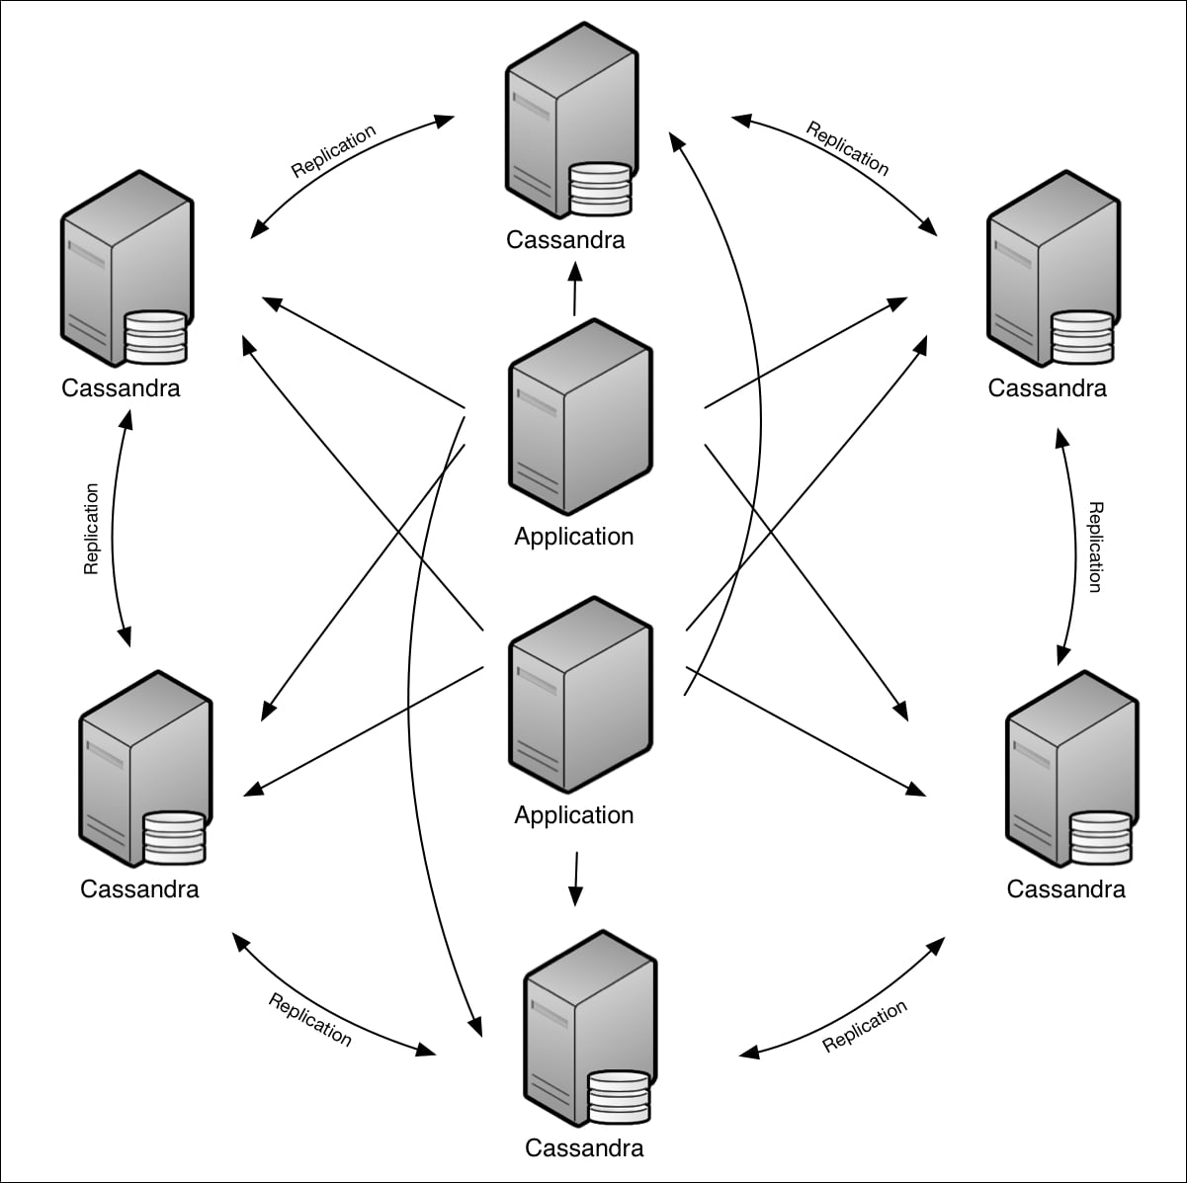

Slide 50
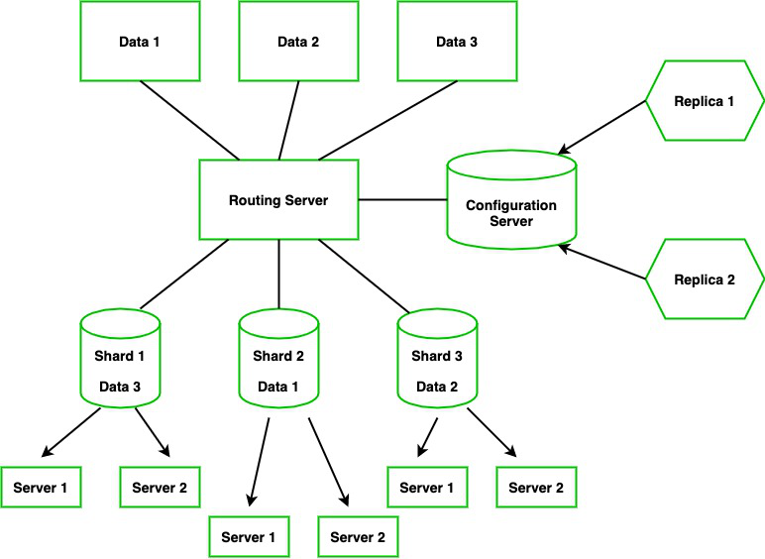
5. Combination of Sharding and Replication
Definition
The Combination of Sharding and Replication is a database architecture where data is first divided into shards (for scalability) and each shard is replicated across multiple nodes (for availability and fault tolerance).
Key Characteristics
Data is partitioned into shards
Each shard has multiple replicas
Supports horizontal scalability
Provides high availability and fault tolerance

Slide 51
Advantages
Handles very large datasets
No single point of failure
High read and write performance
Suitable for distributed systems
Limitations
Complex system design
Difficult maintenance and monitoring
Higher storage and operational cost

